Slide 1
Physical Fulfillment Fundamentals for Loans and Requests
Yoel Kortick
Senior Librarian

Slide 2

Agenda
Introduction
Basic Components
The example fulfillment policy we will set up
The advanced policy configuration for Due Date and Is Loanable
The Terms of Use for type Loan
The item policy
Summary of definitions for loaning
The Fulfillment Unit and Loan Rules
Sample items and patrons and the loans test
Configuring our example for the physical item requests
Testing our configuration for physical item requests

Slide 3
Introduction

Slide 4
Introduction
This presentation will:
  Explain the general components of setting up specific physical fulfillment (circulation) policies regarding the loaning and requesting of physical items
  Make, show and use specific examples of items which (depending on the patron group, item location and item policy)
    May or may not be loaned
    May or may not be requested (physical item request)

Slide 5
Introduction
After defining a specific setup, we will test it using two different patrons on two different items.
Thus, we will show "live" how the various components come together.
Note that some of the "rules" and "units" shown in this presentation may be done on an institution level or library level. We recommend that it be done on the institution level, and in the case here will do it on the institution level.

Slide 6
Basic Components

Slide 7
Basic Components
The Basic Components of Physical Fulfillment Configuration includes:
  The Fulfillment Unit
  The Terms of Use
  The Policy (Advanced Policy Configuration)
  The Item Policy (not mandatory but will be used in our example)

Slide 8
Basic Components
The Fulfillment Unit
  Is a group of locations and corresponding rules for physical items
    It is common that there will be one fulfillment unit in the institution for all locations
    Within the fulfillment unit it is possible to make different rules based on location as well as several other parameters.
  Includes separate definitions (rules) for
    Loans
    Hold requests
      Patron physical item requests
      Patron digitization requests
    Booking
  Utilizes one or more "terms of use" in the "rules"

Slide 9
Basic Components
The Terms of Use
  Is used as part of a fulfillment unit set of rules
  May be one of the following types:
    Incoming Resource Sharing
    Loan
    Request
    Resource Sharing
    User Registration
  Includes fulfillment policies

Slide 10
Basic Components
The Policies (often called “Advanced Policy Configuration” based on the menu entry)
  Are used in the "terms of use"
  Define characteristics such as:
    Number of days for due date (loan period length)
    Number of days for grace period
    If item is
      Loanable
      Requestable
      Digitizable
  Are later used from pull down boxes in the "terms of use".

Slide 11
Basic Components
One fulfillment unit may contain multiple "Terms of Use"
One "Terms of Use" may contain multiple "Item Policies"
Fulfillment Unit
Terms of Use
Terms of Use
Policy
Policy
Policy
Policy
Policy
Policy

Slide 12
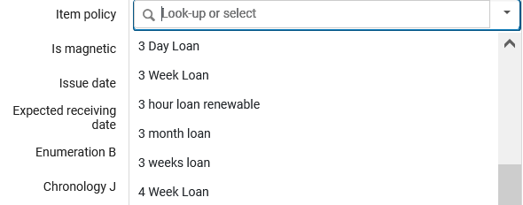
Basic Components
An Item Policy
  May optionally be applied to an item
  An item with no item policy will take definitions from the terms of use based on location and other parameters.
  An item with an item policy may take definitions from the item policy in the terms of use.
The "Item Policy" in the Physical Item Editor.

Slide 13
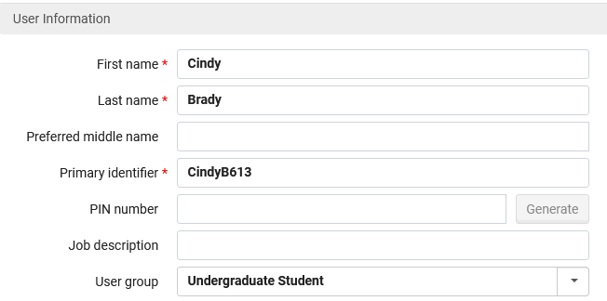
Basic Components
The User Group:
  Mandatory field for patron
  May or may not have influence on fulfillment rules
    Will have effect only if it is in the fulfillment rules as a condition.

Slide 14
The example fulfillment policy we will set up

Slide 15
The example fulfillment policy we will set up
Here is the example fulfillment policy we will set up:
  Any item in the one of the following two locations:
    "Education" library "Education Teaching Center" location (UEDUC:ETC)
    "Education" library "Curriculum Lab" location (UEDUC:CRLAB)
  Will be:
    Loanable
    Requestable
  The loan period will be one week

Slide 16
The example fulfillment policy we will set up
There are exceptions however:
The following are exceptions even though the item is in the "Education Teaching Center" or "Curriculum Lab" location
  If the item has item policy "Four Day Loan" then it will be loanable for four days (instead of one week)
  If the patron has user group "Alumni" then he or she cannot loan the items.
  If the item has item policy "Four Day Loan" then it cannot be requested (physical item request).

Slide 17
The advanced policy configuration for Due Date and Is Loanable

Slide 18
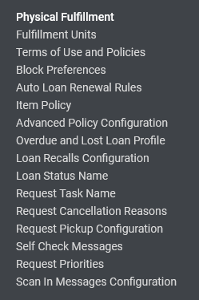
The advanced policy configuration for Due Date and Is Loanable
First, we will make a policy for the 1 week loan period
Access the "Advanced Policy Configuration" via: Configuration > Fulfillment > Physical Fulfillment"

Slide 19
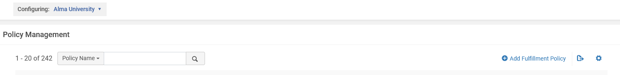
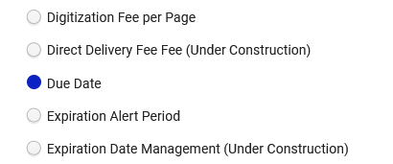
The advanced policy configuration for Due Date and Is Loanable
Create a new policy or edit an existing one.
The policy type will be defined as "Due Date"
Note that we are configuring on the level of the institution

Slide 20
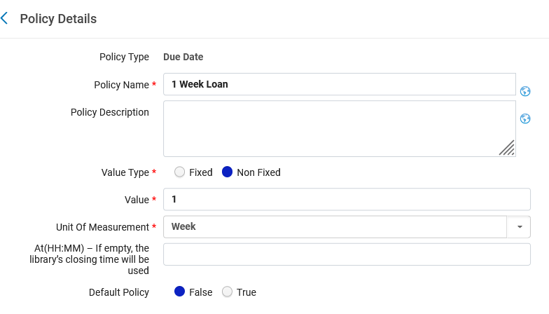
The advanced policy configuration for Due Date and Is Loanable
And it will be for a non-fixed value of 1 week and call it "1 Week Loan".
This policy will soon be chosen from a pull-down box in the "Terms of Use"

Slide 21
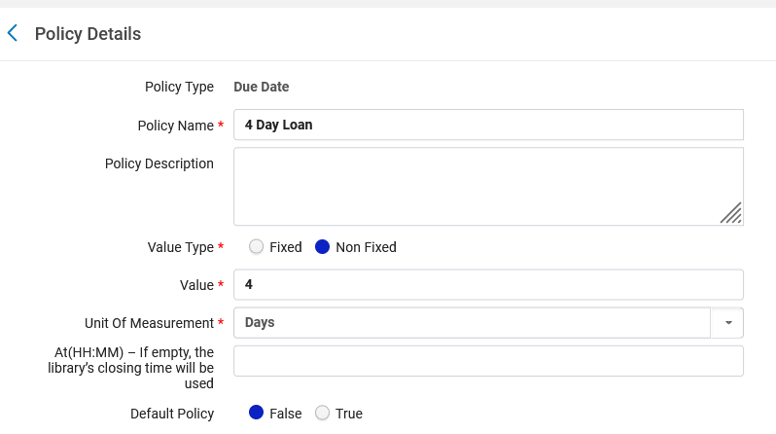
The advanced policy configuration for Due Date and Is Loanable
We will also make a policy for a 4-day loan
This policy will soon be chosen from a pull-down box in the "Terms of Use"

Slide 22
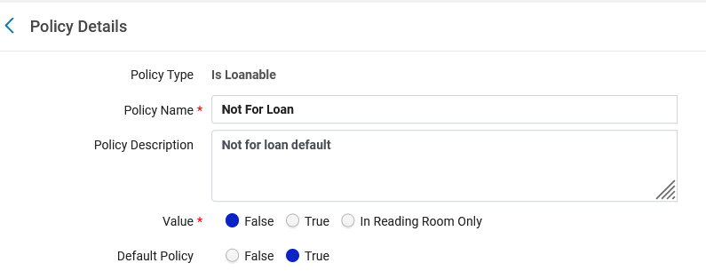
The advanced policy configuration for Due Date and Is Loanable
Note that we also have a policy of type "Is Loanable" which is called "Not For Loan" and has vale "false" (because it is not for loan)

Slide 23
The Terms of Use for type Loan

Slide 24
The Terms of Use for type Loan
Now we will make a terms of use for the general rule of 1 week loan with items loanable.
Access the "Terms of Use" via: "Configuration > Fulfillment > Physical Fulfillment"

Slide 25
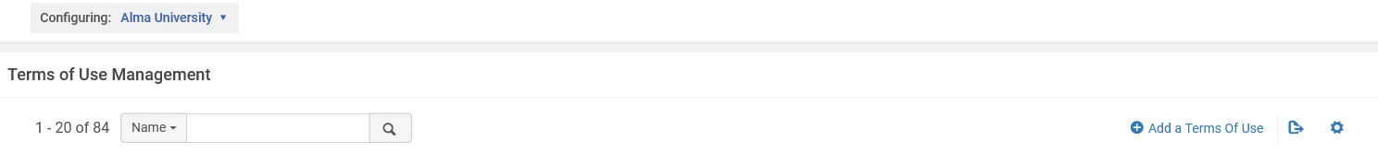
The Terms of Use for type Loan
Add the "Terms of Use" (it is also possible to edit an existing one)
Note that we are configuring on the level of the institution

Slide 26
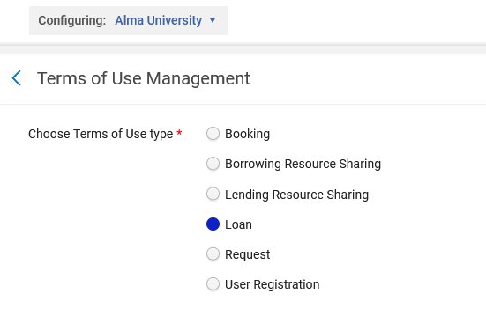
The Terms of Use for type Loan
This "Terms of Use" is of type "Loan"

Slide 27
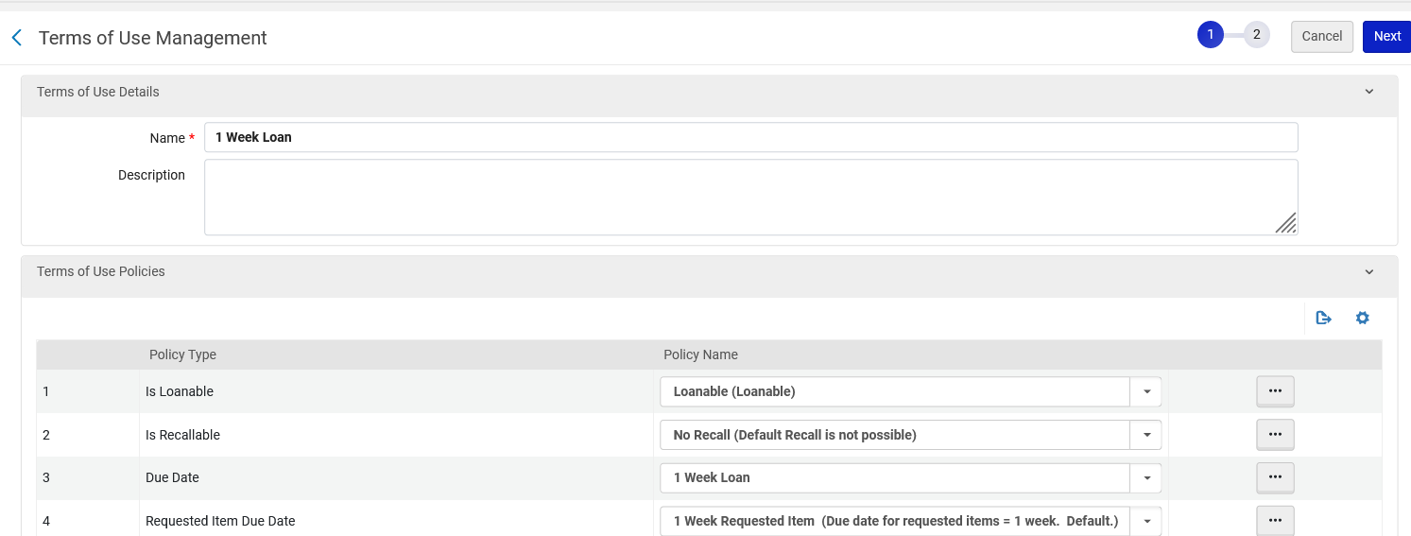
The Terms of Use for type Loan
In "Due Date" field we use policy "1 Week Loan", which we created a few moments ago.
We have named the Terms of Use "1 Week Loan"
Here we have chosen (from a pull-down box) the policy which we previously built and defined
Item "Is Loanable"

Slide 28
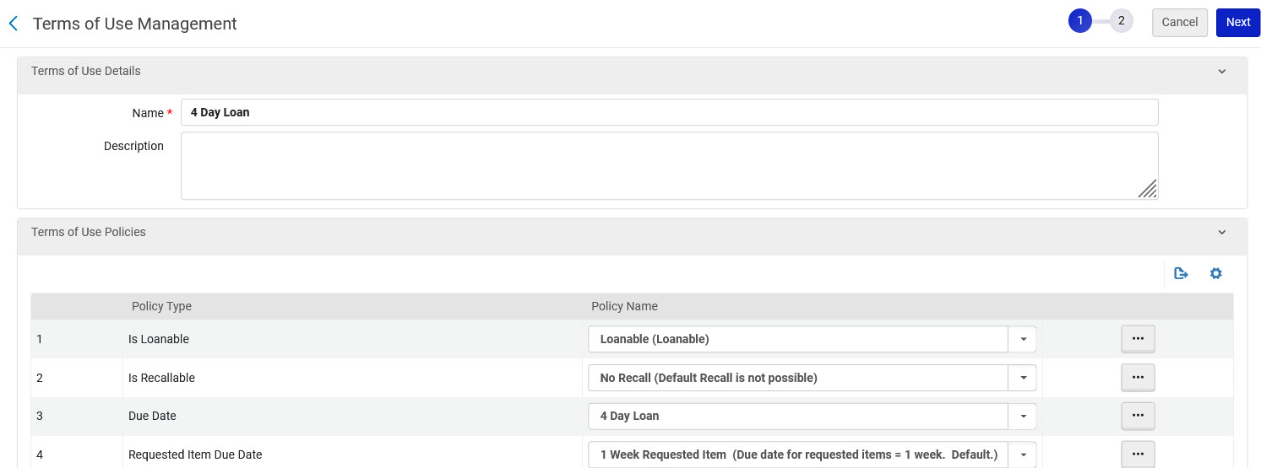
The Terms of Use for type Loan
We also create a Terms of Use called "4 Day Loan" and use the policy "4 Day Loan" which we created a few moments ago.
We have named the Terms of Use "Four Day Loan"
Here we have chosen (from a pull-down box) the policy which we previously built and defined
Item "Is Loanable"

Slide 29
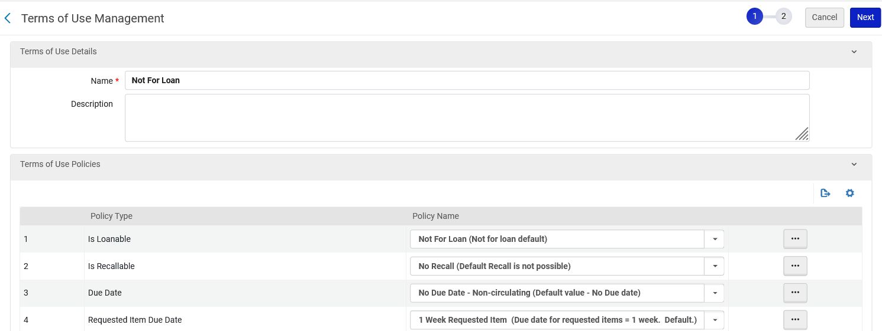
The Terms of Use for type Loan
We will also create a third terms of use for type Loan which is called "Not for loan".
We have named the Terms of Use "Not For Loan"
The item will not be loanable

Slide 30
The item policy

Slide 31
The item policy
Now we will make an item policy called "4 Day Loan"
Access the "Item Policy" via: "Configuration > Fulfillment > Physical Fulfillment"

Slide 32
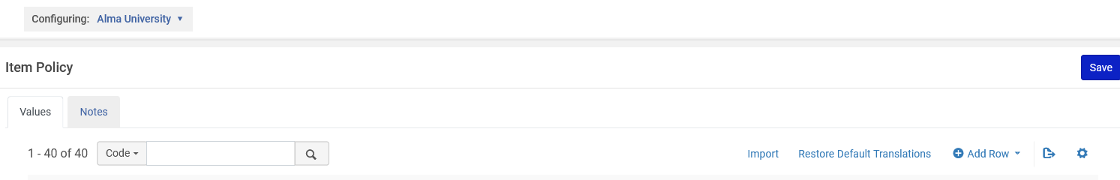
The item policy
Add the "Item Policy" (it is also possible to edit an existing one)
Note that we are configuring on the level of the institution

Slide 33
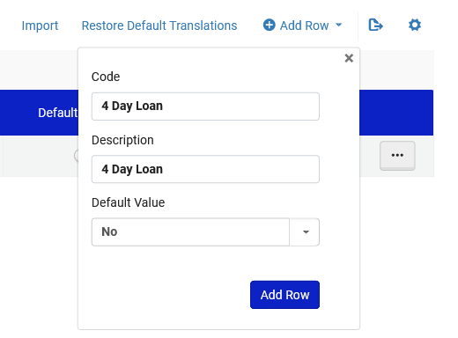
The item policy
Give the "Item Policy" a code and description

Slide 34
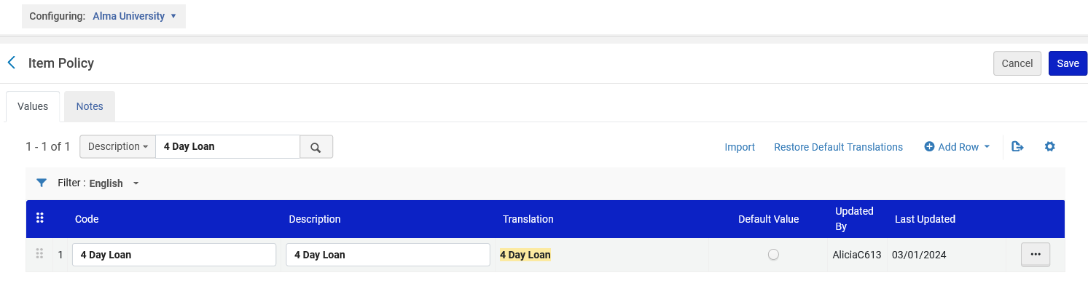
The item policy
Here is the "Item Policy"

Slide 35
Summary of definitions for loaning

Slide 36
Summary of definitions for loaning
We have three terms of use
  Terms of Use called "1 Week Loan" which uses policy of type "Due Date" called "1 Week Loan"
  Terms of Use called "4 Day Loan" which uses policy of type "Due Date" called "4 Day Loan"
  Terms of Use called "Not For loan" which uses policy of type "Is Loanable" called "Not For Loan"
We have an item policy called "4 Day Loan"
Summary

Slide 37
The Fulfillment Unit and Loan Rules

Slide 38
The Fulfillment Unit and Loan Rules
Every location is attributed to a "Fulfillment Unit".
Access the "Fulfillment Units" via: Configuration > Fulfillment > Physical Fulfillment"

Slide 39
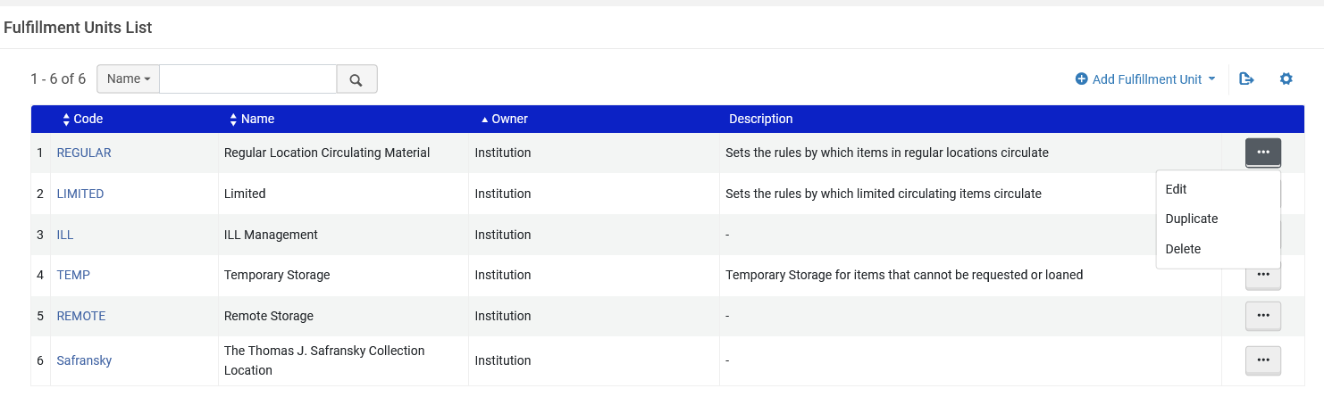
The Fulfillment Unit and Loan Rules
We will now look at the "Fulfillment Unit" called "Regular Location Circulating Material".

Slide 40
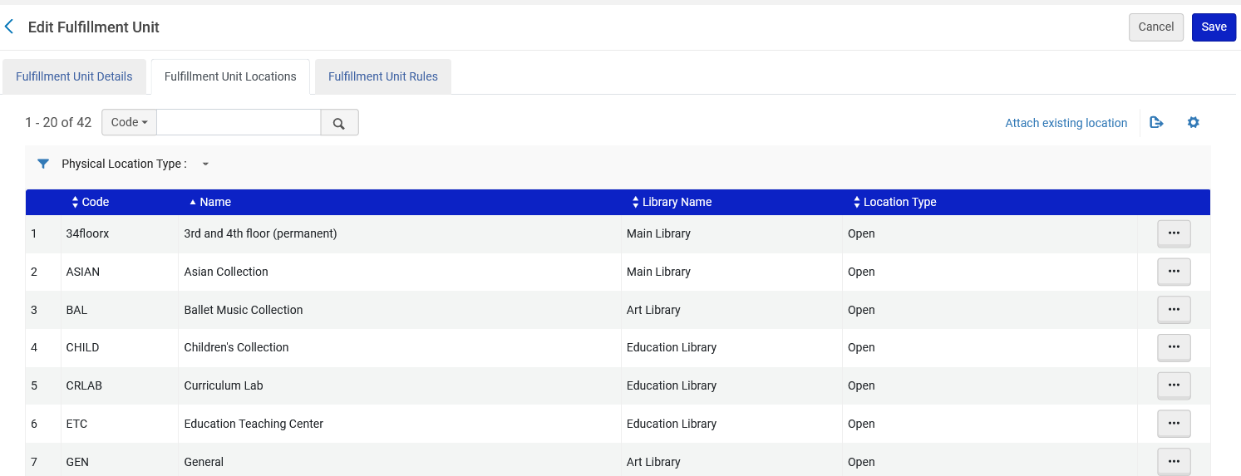
The Fulfillment Unit and Loan Rules
The "Fulfillment Unit" called "Regular Location Circulating Material" includes (among others) the two locations which we plan to use in our example

Slide 41
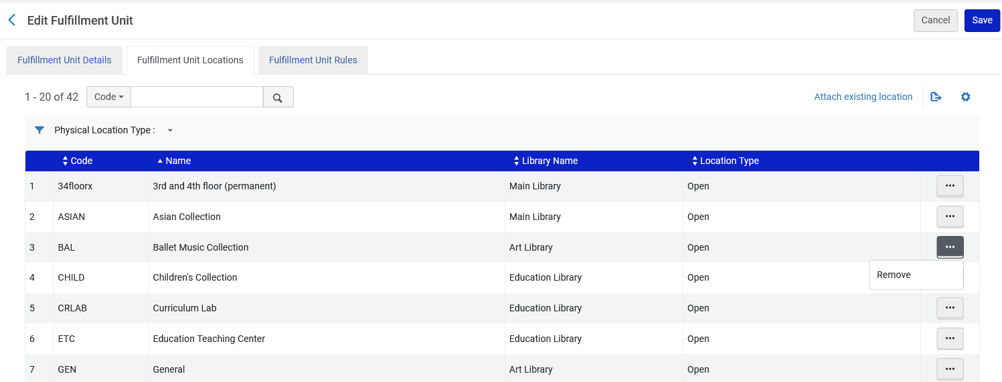
The Fulfillment Unit and Loan Rules
Locations can be added to and removed from the "Fulfillment Unit"

Slide 42
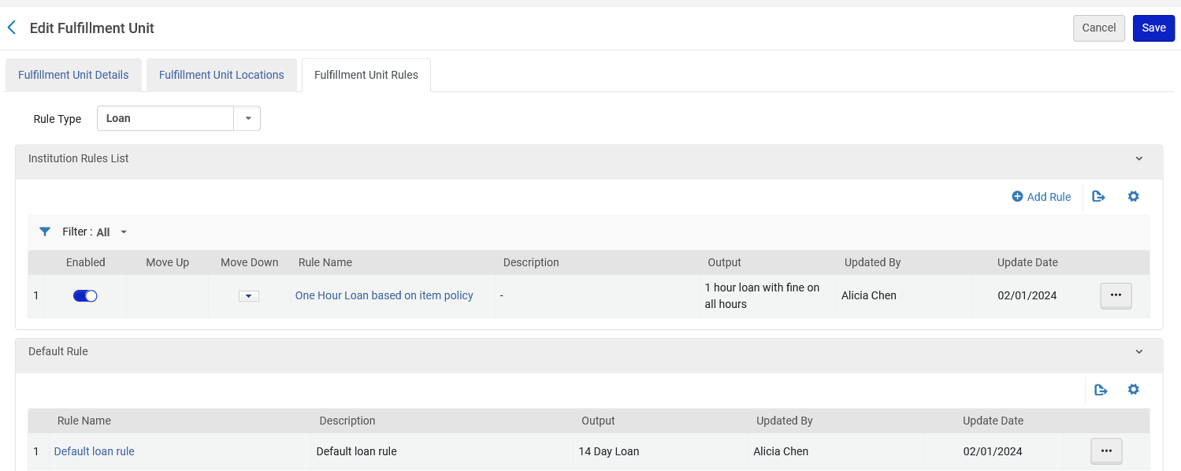
The Fulfillment Unit and Loan Rules
In the "Fulfillment Unit Rules" tab we will add a rule.
Note that we are adding a rule of type "Loan"

Slide 43
The Fulfillment Unit and Loan Rules
Our rule will define as follows:
If the location equals one of the following:
  "Education" library "Education Teaching Center" location (UEDUC:ETC)
  "Education" library "Curriculum Lab" location (UEDUC:CRLAB)
Then the item will be loanable for one week
There are exceptions however:
  If the item has item policy "4 Day Loan" then it will be loanable for four days (instead of one week)
  If the patron has user group "Alumni" then he or she cannot loan an item in one of these locations.

Slide 44
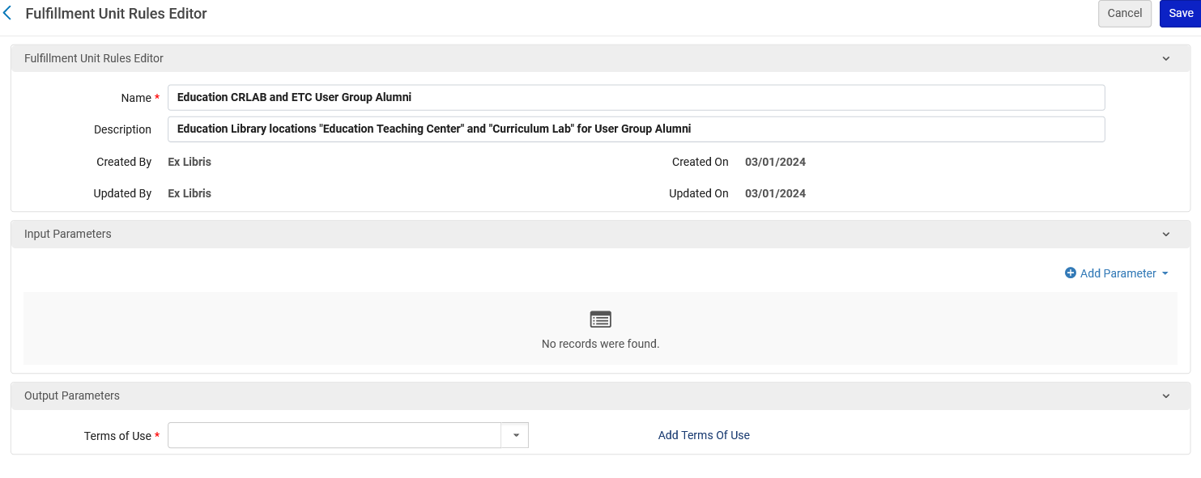
The Fulfillment Unit and Loan Rules
We have given the fulfillment unit rule a name "Education CRLAB and ETC User Group Alumni" and corresponding description
Now we will add a parameter

Slide 45
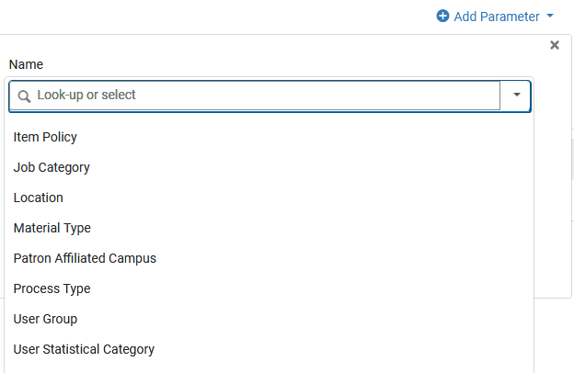
The Fulfillment Unit and Loan Rules
Here are the parameters which can be chosen

Slide 46
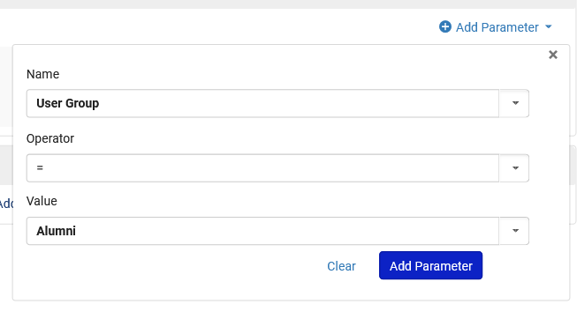
The Fulfillment Unit and Loan Rules
The first parameter we will choose is "patron user group = "Alumni""

Slide 47
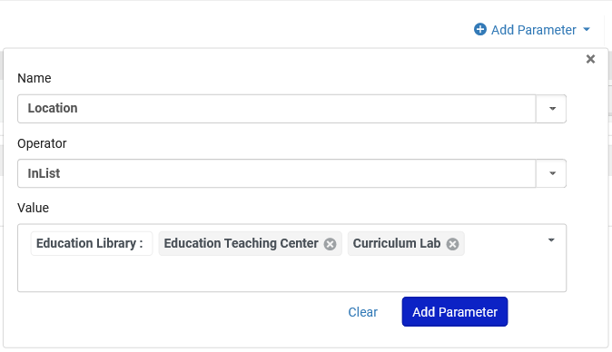
The Fulfillment Unit and Loan Rules
The second parameter we will choose is "Location is InList "Education Teaching Center" , "Curriculum Lab""

Slide 48
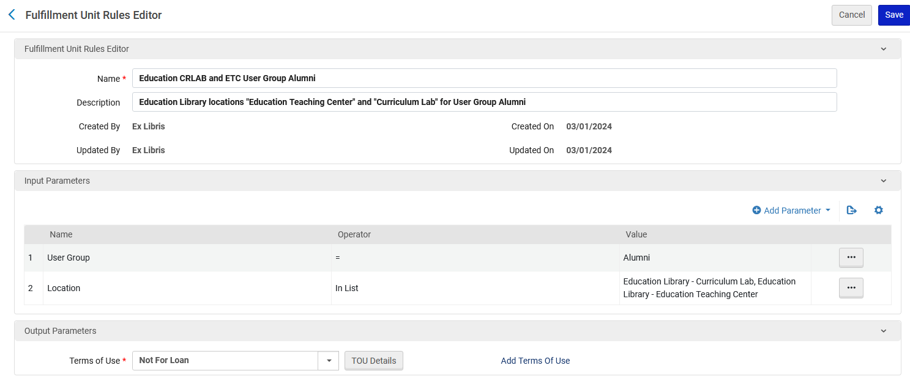
The Fulfillment Unit and Loan Rules
After adding both parameters we have chosen that when both conditions are met the Terms Of Use (which we created a few moments ago) called "Not for Loan" will be used.
The User Group is "Alumni"

Slide 49
The Fulfillment Unit and Loan Rules
The rule we created is named "Education CRLAB and ETC User Group Alumni" and defines that if the user group is Alumni and the location is either CRLAB or ETC then the item is not for loan.
Now we will make a rule named "Education CRLAB and ETC User Group not Alumni" and define that if the user group is not Alumni and the location is either "Education Library - Curriculum Lab" or "Education Library - Education Teaching Center" then the item can be loaned for one week (It will use the Terms of Use which we created a few moments ago called "One Week Loan".

Slide 50
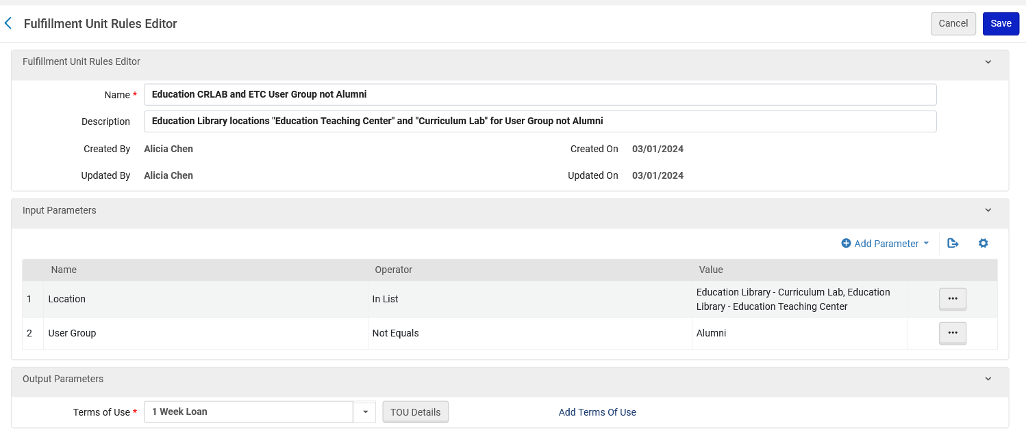
The Fulfillment Unit and Loan Rules
After adding both parameters we have chosen that when both conditions are met the Terms Of Use (which we created a few moments ago) called "1 Week Loan" will be used.
The User Group is not "Alumni"

Slide 51
The Fulfillment Unit and Loan Rules
Now we will make a rule named "Education CRLAB and ETC Item Policy 4 Day Loan" and define that if the item policy is "4 Day Loan" and the location is either "Education Library - Curriculum Lab" or "Education Library - Education Teaching Center" then the item can be loaned for 4 days (It will use the Terms of Use which we created a few moments ago called "4 Day Loan").

Slide 52
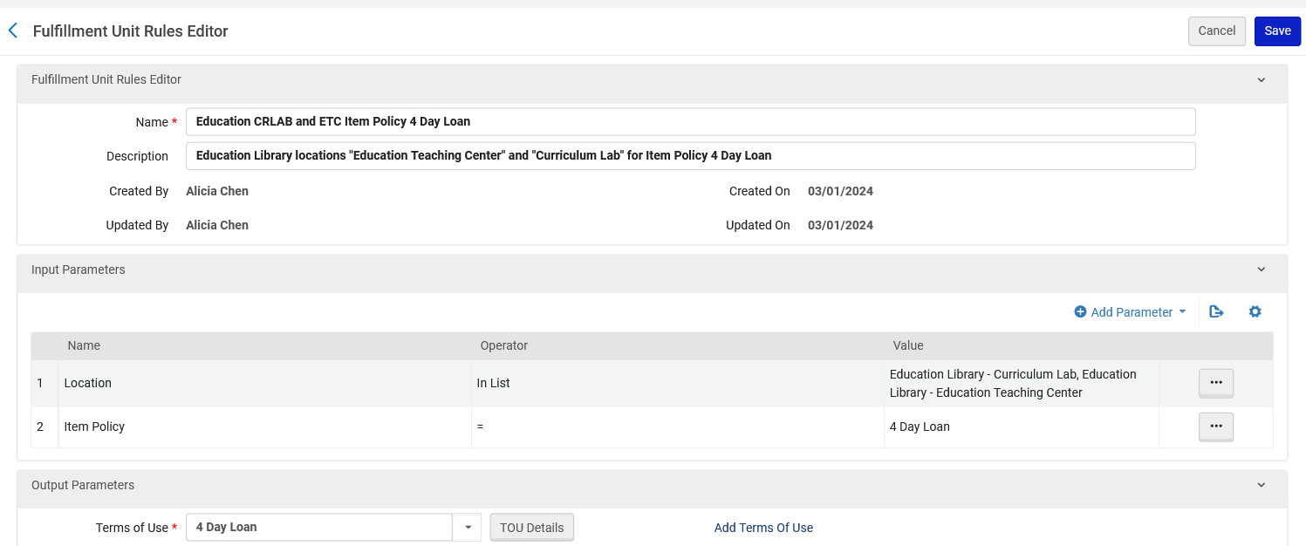
The Fulfillment Unit and Loan Rules
After adding both parameters we have chosen that when both conditions are met the Terms Of Use (which we created a few moments ago) called "4 Day Loan" will be used.
Define the location and item policy

Slide 53
The Fulfillment Unit and Loan Rules
The rules are read top to bottom, so the order is important. We want the rules to appear in the following order:
The rule regarding the user group Alumni and relevant locations to be read so that if the user group is Alumni, then the loan will be blocked, and no other rules will be applied.
The rule regarding the item policy "4 Day Loan" and relevant locations to be read so that if the item policy is "4 Day Loan", then the loan will be made for 4 days, and no other rules will be applied.
The rule regarding the locations and that the user group is not Alumni so that the loan will be made for 1 week.

Slide 54
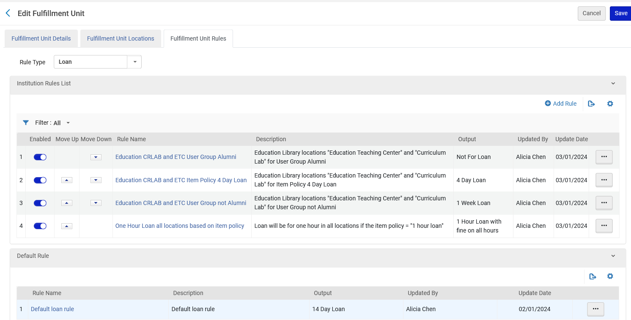
The Fulfillment Unit and Loan Rules
The three rules we have created
Another rule regarding items in this fulfillment unit
The default rule which gets applied if no above conditions are met.

Slide 55
Sample items and patrons and the loans test

Slide 56
Sample items and patrons and the loans test
Item barcode 529127494 is in "Education Library" "Curriculum Lab" Location and has item policy "4 day loan".
Item barcode 872740708 is in is in "Education Library" "Education Teaching Center" Location and has no item policy.
Patron "Brady, Jan" has user group "Alumni".
Patron "Howell, Thurston" has user group "Undergraduate".

Slide 57
Sample items and patrons and the loans test
Both of these items:
  Item barcode 529127494 is in "Education Library" "Curriculum Lab" Location and has item policy "4 day loan"
  Item barcode 872740708 is in is in "Education Library" "Education Teaching Center" Location and has no item status
Should not be able to be loaned to Patron "Brady, Jan" who has user group "Alumni".

Slide 58
Sample items and patrons and the loans test
Both of these items:
  Item barcode 529127494 is in "Education Library" "Curriculum Lab" Location and has item policy "4 day loan"
  Item barcode 872740708 is in is in "Education Library" "Education Teaching Center" Location and has no item status
Should be able to be loaned to Patron "Howell, Thurston" who has user group "Undergraduate".
  Item barcode 529127494 should be loaned for 4 days
  Item barcode 872740708 should be loaned for 1 week

Slide 59
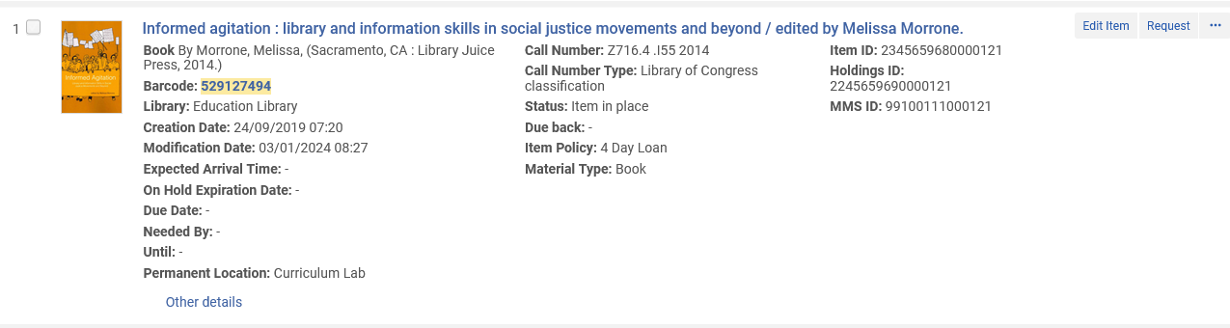
Sample items and patrons and the loans test
Here is barcode 529127494
This item has item policy "4 Day Loan"

Slide 60
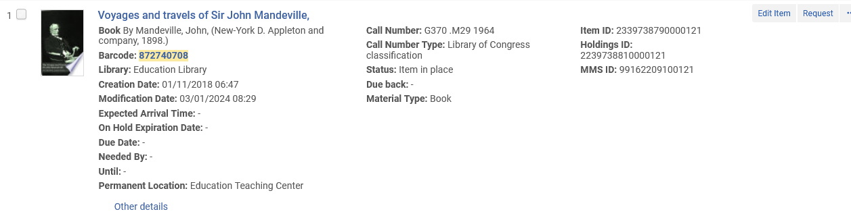
Sample items and patrons and the loans test
Here is barcode 872740708
This item does not have an item policy

Slide 61
Sample items and patrons and the loans test
Here is patron "Brady, Jan"
Here is patron "Howell, Thurston"

Slide 62
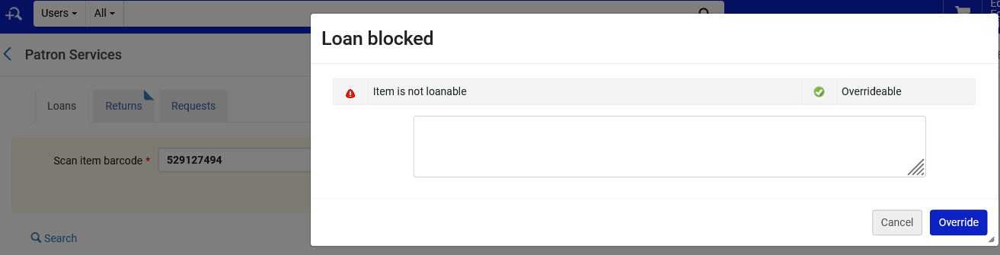
Sample items and patrons and the loans test
If we try to loan item barcode 529127494 to Jan Brady, then it cannot be loaned.

Slide 63
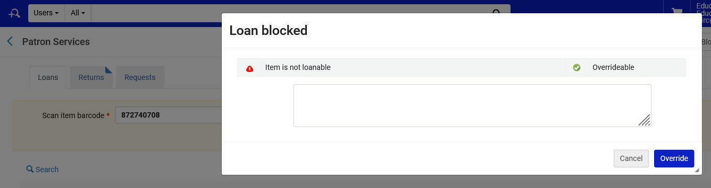
Sample items and patrons and the loans test
If we try to loan item barcode 872740708 to Jan Brady, then it cannot be loaned.

Slide 64
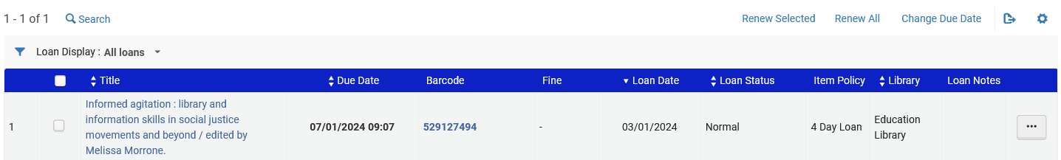
Sample items and patrons and the loans test
If we try to loan item barcode 529127494 to Thurston Howell, then it gets loaned for 4 days.
Loaned Jan. 03 and due Jan. 7.
7 – 3 = 4

Slide 65
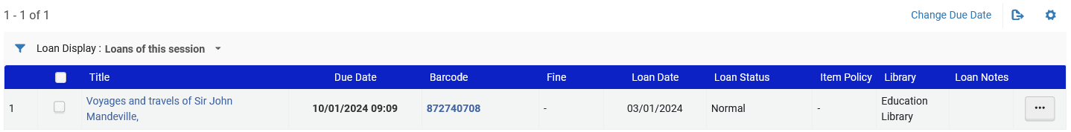
Sample items and patrons and the loans test
If we try to loan item barcode 872740708 to Thurston Howell, then it gets loaned for 7 days.
Loaned Jan. 03 and due Jan. 10.
10 – 3 = 7

Slide 66
Configuring our example for the physical item requests

Slide 67
Configuring our example for the physical item requests
The configuration for the physical item requests is similar to how we did the configuration for the loans (creating advanced policies, terms of use and rules).
As a result, we will not go into the same depth of detail in this example, not showing how to navigate to the different parts of the system
We will utilize the item policy "4 day loan" which we already created.
In our tests we will use the same items and patrons which we used in our loans test.

Slide 68
Configuring our example for the physical item requests
We will create a configuration whereby:
If an item is in the Education Library in one of the following two locations:
  "Education Teaching Center"
  "Curriculum Lab" location
Then
  If the item has item policy "Four Day Loan" then it is not requestable (physical item request).
  If the item does not have item policy "Four Day Loan" then it is requestable (physical item request).

Slide 69
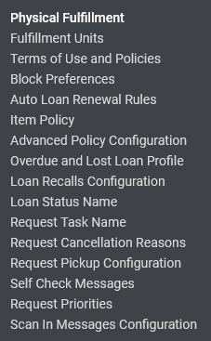
Configuring our example for the physical item requests
First, we will confirm that we have an "Advanced Policy Configuration" of type "Is Requestable" for both "Requestable" and "Not Requestable"

Slide 70
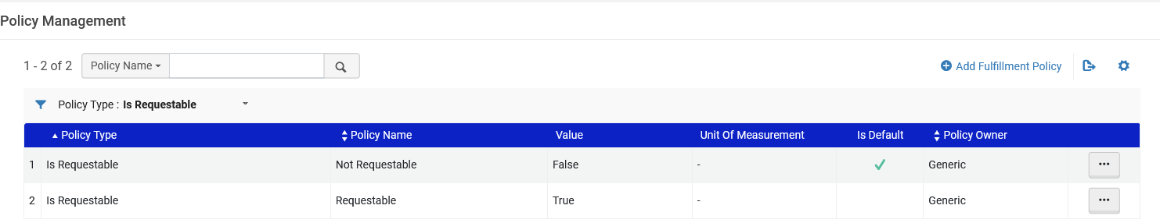
Configuring our example for the physical item requests
We have both Advanced Policy Configurations

Slide 71
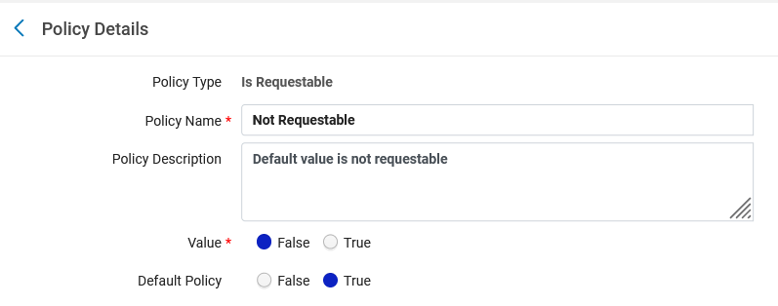
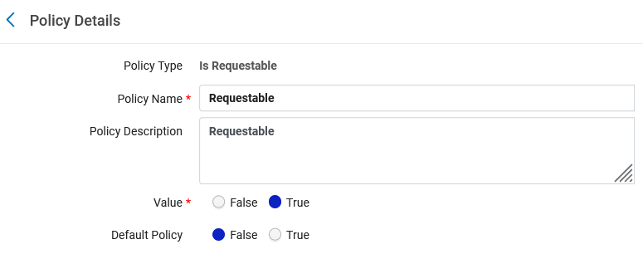
Configuring our example for the physical item requests
Here are the Advanced Policy Configurations

Slide 72
Configuring our example for the physical item requests
Next, we will confirm that we have a "Terms of Use" of type "Request" for both "Requests allowed" and "No requests allowed"

Slide 73
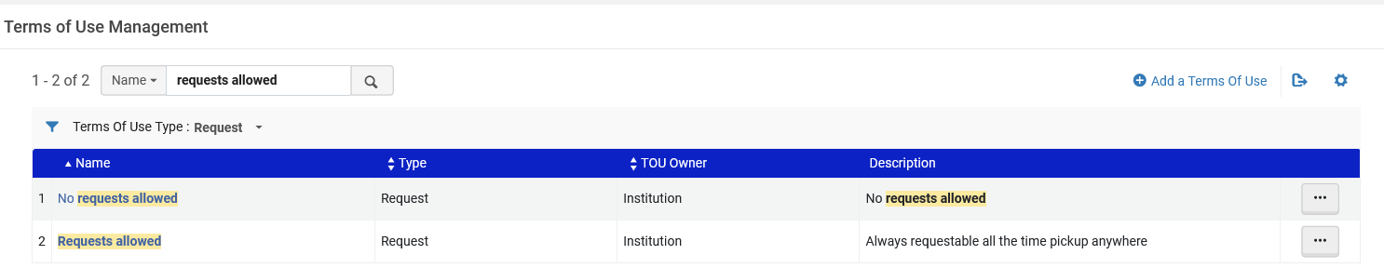
Configuring our example for the physical item requests
We have both Terms of Use
If the terms of use do not exist add them

Slide 74
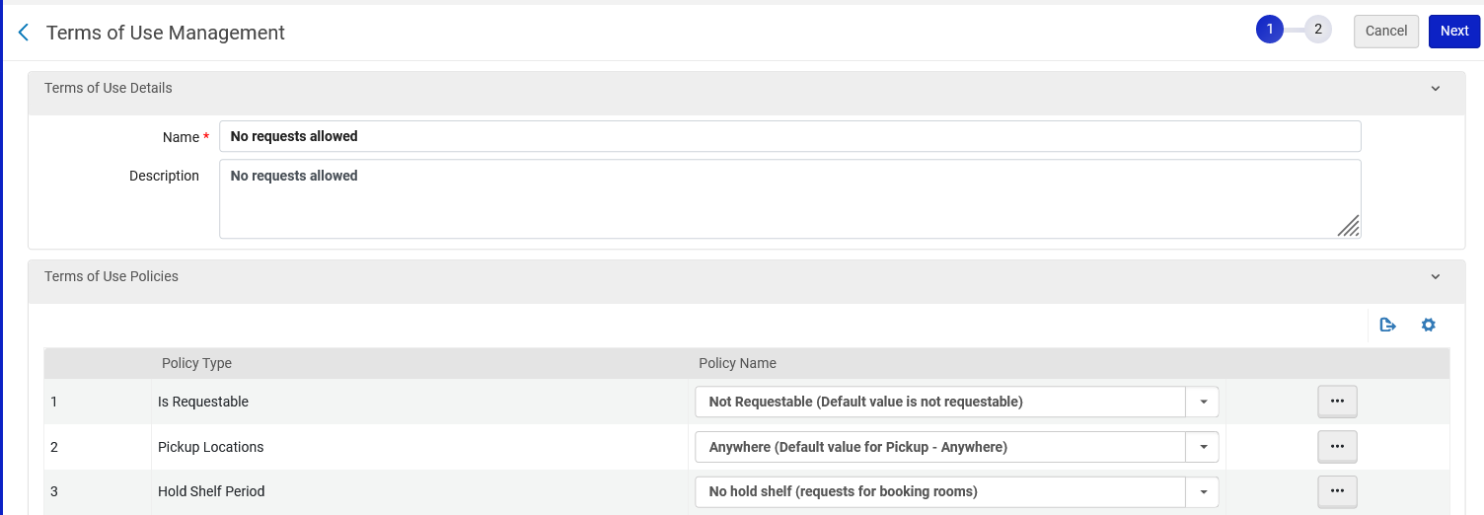
Configuring our example for the physical item requests
Here is the Terms of Use "No requests allowed"
This is the advanced policy configuration which we saw a moment ago. Requests are not allowed

Slide 75
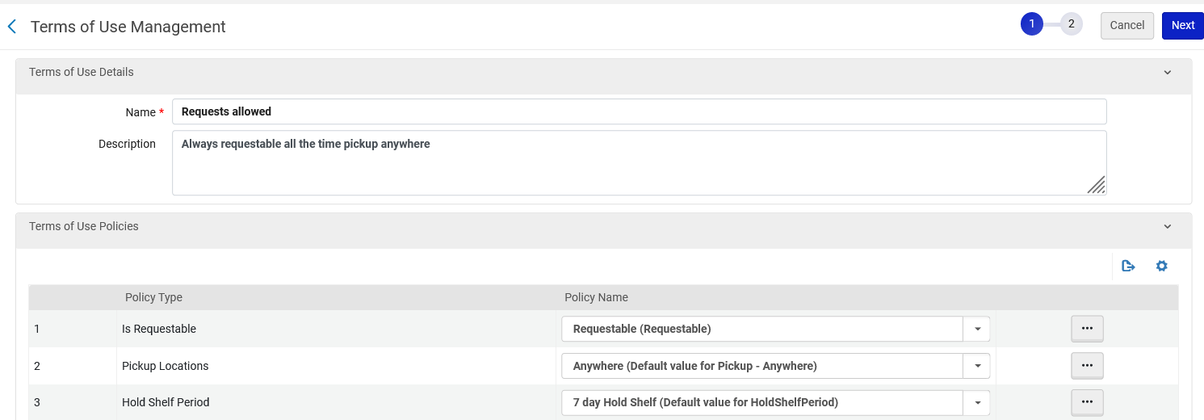
Configuring our example for the physical item requests
Here is the Terms of Use "Requests allowed"
This is the advanced policy configuration which we saw a moment ago. Requests are allowed

Slide 76
Configuring our example for the physical item requests
Now we need to go to the relevant fulfillment unit and define relevant rules of type "Request"

Slide 77
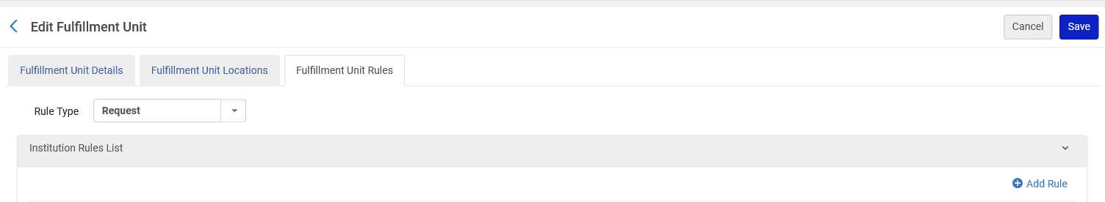
Configuring our example for the physical item requests
From the "Fulfillment Unit Rules" tab we will filter by "Rule Type" = "Request" and click "Add Rule"

Slide 78
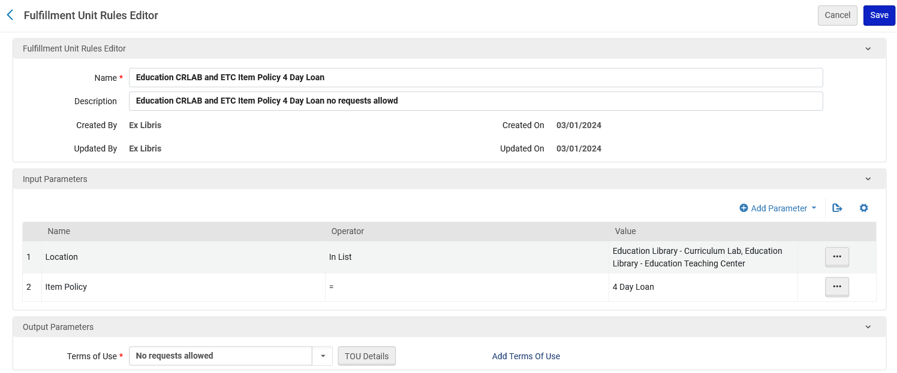
Configuring our example for the physical item requests
We have created a fulfillment unit rule called "Education CRLAB and ETC Item Policy 4 Day Loan" with description "Education CRLAB and ETC Item Policy 4 Day Loan no requests allowed"
This is the Terms of Use we saw a moment ago

Slide 79
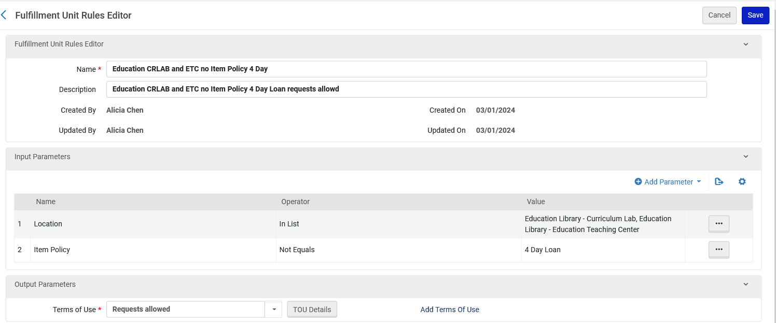
Configuring our example for the physical item requests
We have also created a fulfillment unit rule called "Education CRLAB and ETC no Item Policy 4 Day Loan" with description "Education CRLAB and ETC Item Policy 4 Day Loan requests allowed"
This is the Terms of Use we saw a moment ago

Slide 80
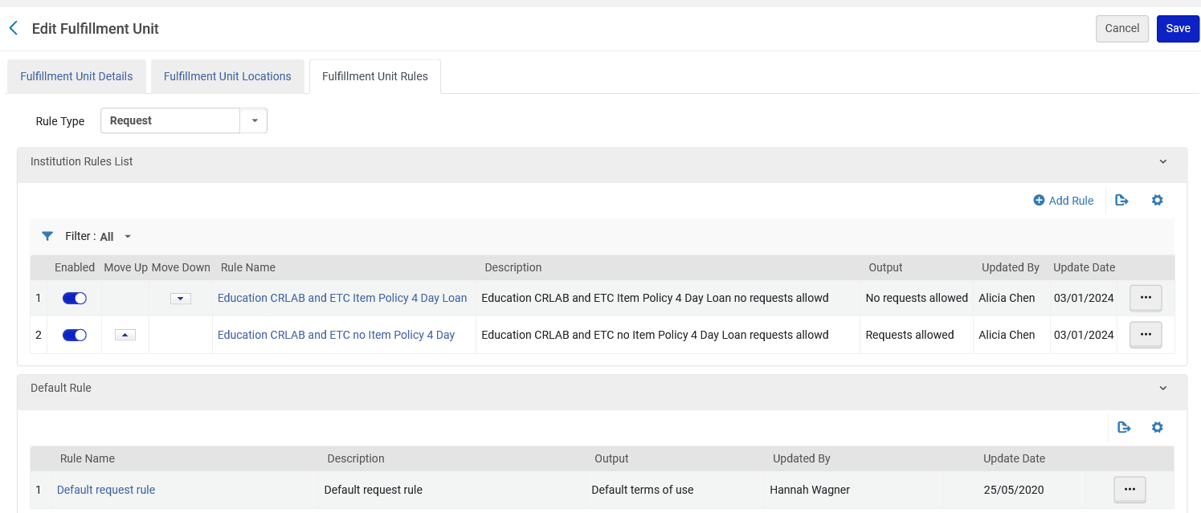
Configuring our example for the physical item requests
The two rules we have created
The default rule which gets applied if no above conditions are met.

Slide 81
Testing our configuration for physical item requests

Slide 82
Testing our configuration for physical item requests
We will use these same two items for our tests:
  Item barcode 529127494 is in "Education Library" "Curriculum Lab" Location and has item policy "4 day loan"
  Item barcode 872740708 is in is in "Education Library" "Education Teaching Center" Location and has no item status
We should not be able to make a request on item barcode 529127494 because it does have item policy "4 day loan".
We should be able to make a request on item barcode 872740708 because it does not have item policy "4 day loan".

Slide 83
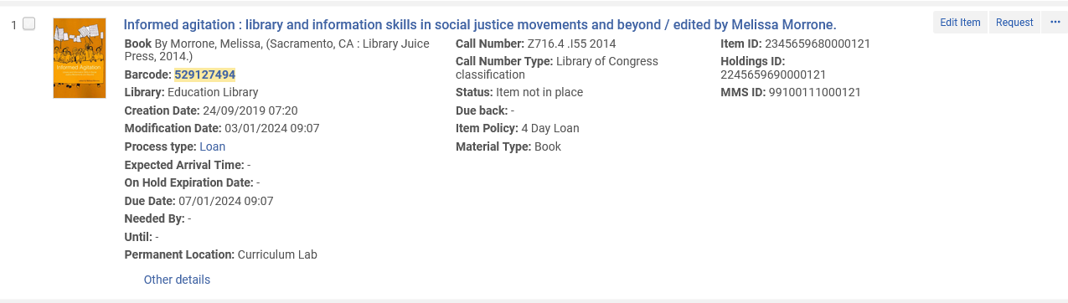
Testing our configuration for physical item requests
We will try to make a request for item barcode 529127494

Slide 84
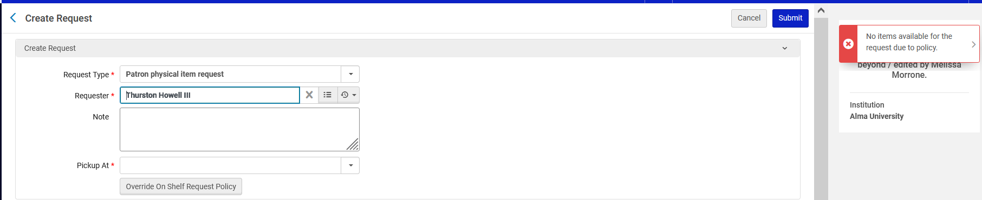
Testing our configuration for physical item requests
We cannot make the request for item barcode 529127494
We get message "No items available for the request due to policy".

Slide 85
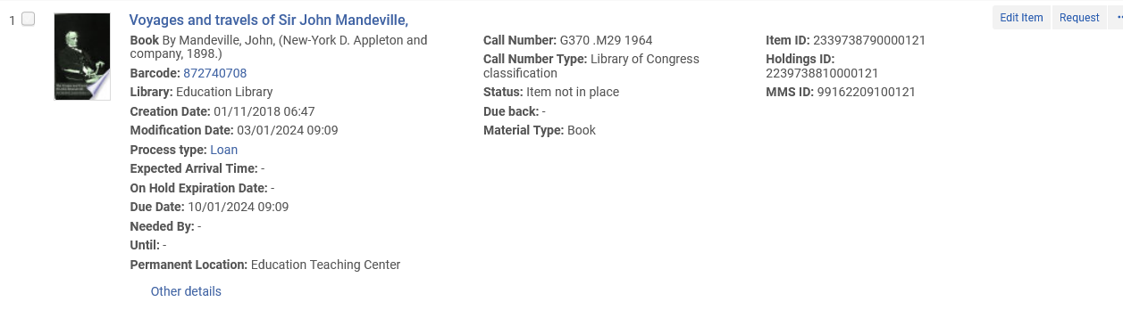
Testing our configuration for physical item requests
We will try to make a request for item barcode 872740708

Slide 86
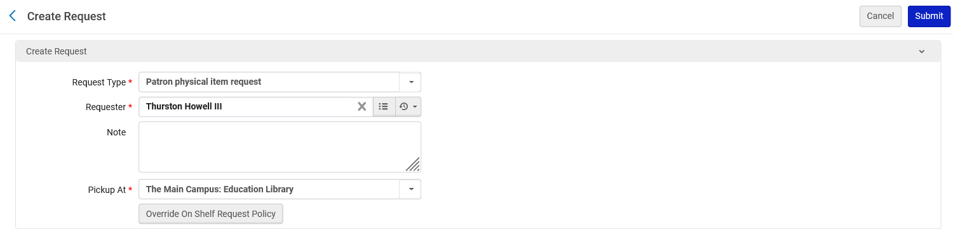
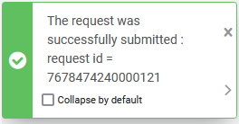
Testing our configuration for physical item requests
We can make the request for item barcode 872740708

Slide 87

Testing our configuration for physical item requests
The request was made for item barcode 872740708

